Slide 1
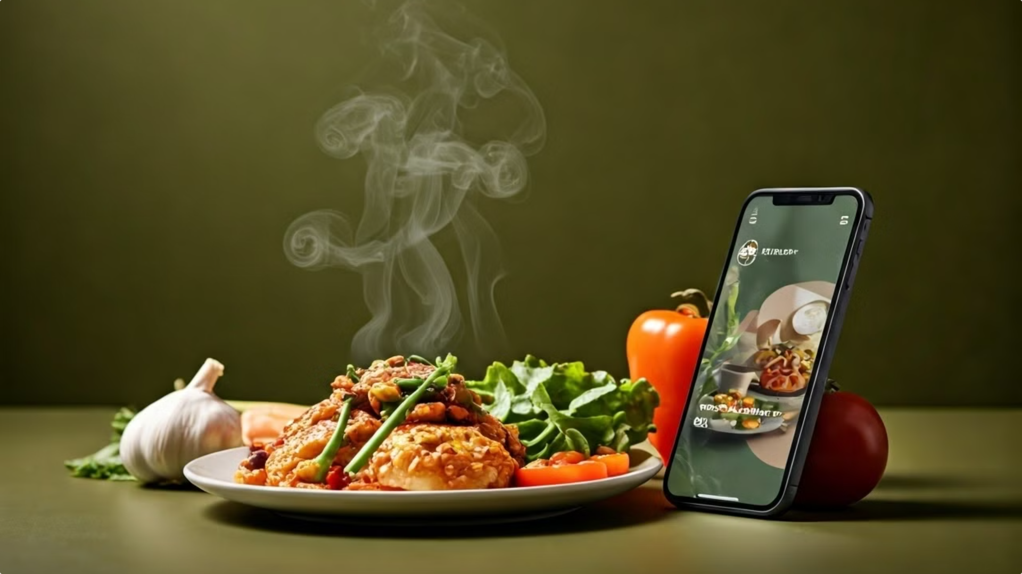



Tomato
Wake up it’s food ‘o’ clock
Tomato is a revolutionary food delivery app that brings the flavor of your favorite local restaurants right to your door, with seamless ordering and fast, reliable service.

Slide 2

Project Title: TOMATO
Team Members:A.Shashidhar
J.Mukesh
G.Bhagath
Course: Human-Computer Interface
Instructor: Faiza iram
Date:6-11-24

Slide 3
Project Objective
Enhance User Experience
Foster Community Connections
Streamline the food ordering and delivery process, making it efficient and enjoyable for users.
Bring people together through the shared experience of delicious, locally-sourced meals.
1
2
3
Support Local Businesses
Provide a platform for local restaurants to expand their reach and connect with more customers.

Slide 4
Target Audience
Busy Professionals
Families and Households
Food Enthusiasts
Individuals who value convenience and quick access to a variety of meal options to fit their on-the-go lifestyle.
Households looking for a hassle-free way to enjoy delicious, family-friendly meals without the effort of cooking.
People who appreciate the diverse culinary offerings of their local community and want to explore new flavors.

Slide 5
Identifying User Needs and Challenges
1
Convenient Ordering
2
Reliable Delivery
Users want a seamless, user-friendly ordering process that saves time and effort.
Customers expect their meals to arrive hot and fresh, within a reasonable timeframe.
3
Diverse Menu Options
4
Transparent Pricing
Users want access to a wide variety of cuisines and dietary preferences to cater to their diverse tastes.
Customers seek clear and upfront pricing information, with no hidden fees or surcharges.

Slide 6

Inspiration and Initial Idea
Leveraging Technology for Seamless Dining Experiences
Connecting Local Restaurants with Hungry Customers

Slide 7




Core Features of Tomato
Intuitive Search
Seamless Ordering
Real-Time Tracking
User Reviews
Easily find your favorite local restaurants or discover new ones based on cuisine, dietary preferences, and reviews.
Add items to your cart, customize your order, and checkout with just a few taps.
Monitor the progress of your order and receive updates on the estimated delivery time.
Browse ratings and read reviews from other customers to make informed dining choices.

Slide 8
User Personas and Interface Interactions
Busy Professional: Sarah
Family: The Johnsons
Food Enthusiast: Alex
Sarah, a marketing executive, relies on Tomato to provide quick and convenient access to a variety of meal options that fit her hectic schedule.
The Johnson family, with two young children, uses Tomato to order family-friendly meals that cater to everyone's tastes and dietary needs.
Alex, a local food critic, appreciates Tomato's ability to connect him with the diverse culinary offerings of his community.

Slide 9
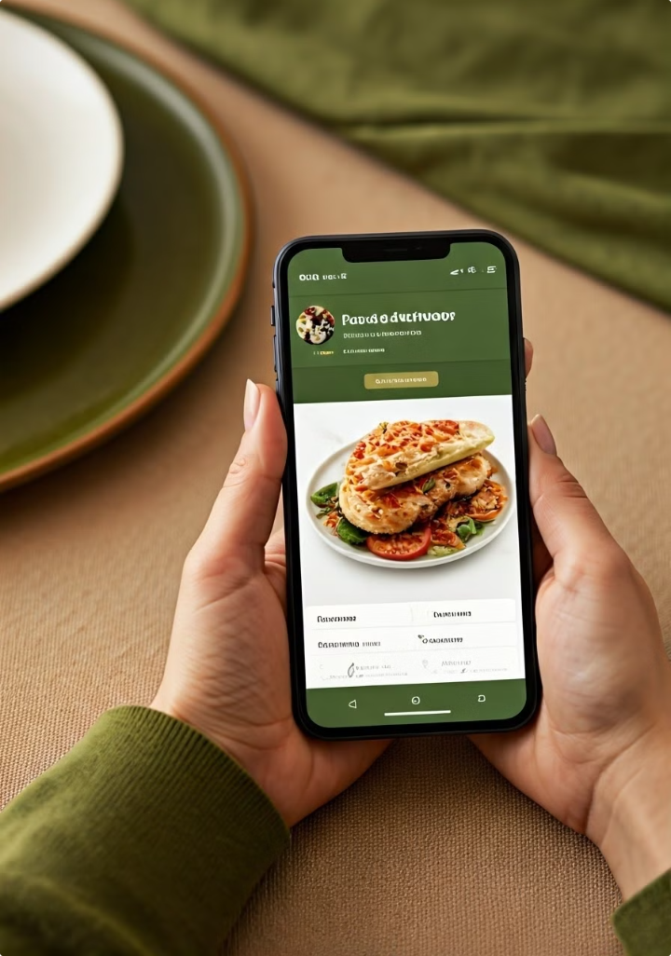



Sitemap, Flowcharts, and Wireframe Sketches
Home Screen
Users can browse popular restaurants, search for specific cuisine, and access their order history.
Restaurant Menu
Users can explore the menu, customize their orders, and add items to their cart.
Checkout and Delivery
Users can complete their order, select a delivery time, and track the status of their order.
User Account and Settings

Slide 10
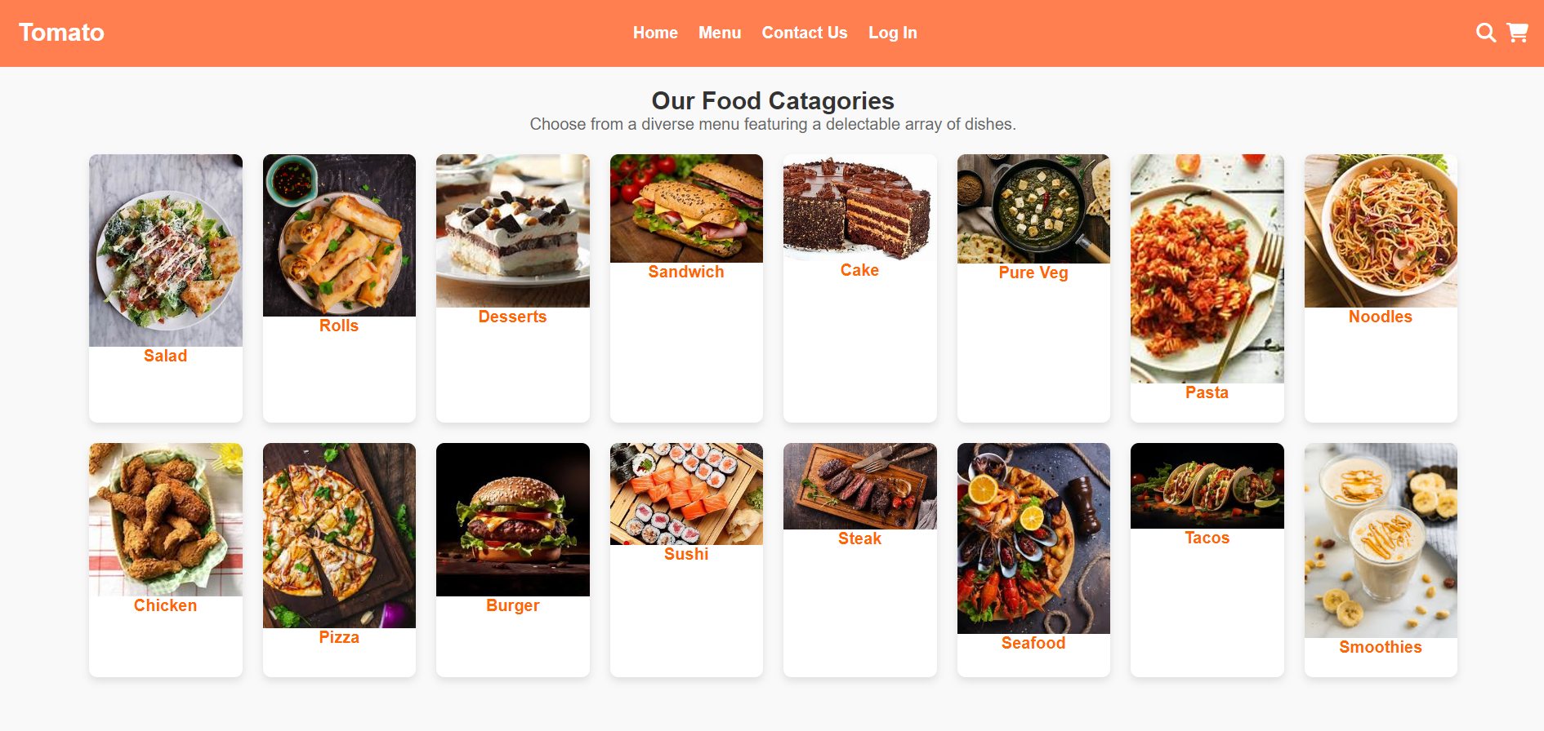

Slide 11
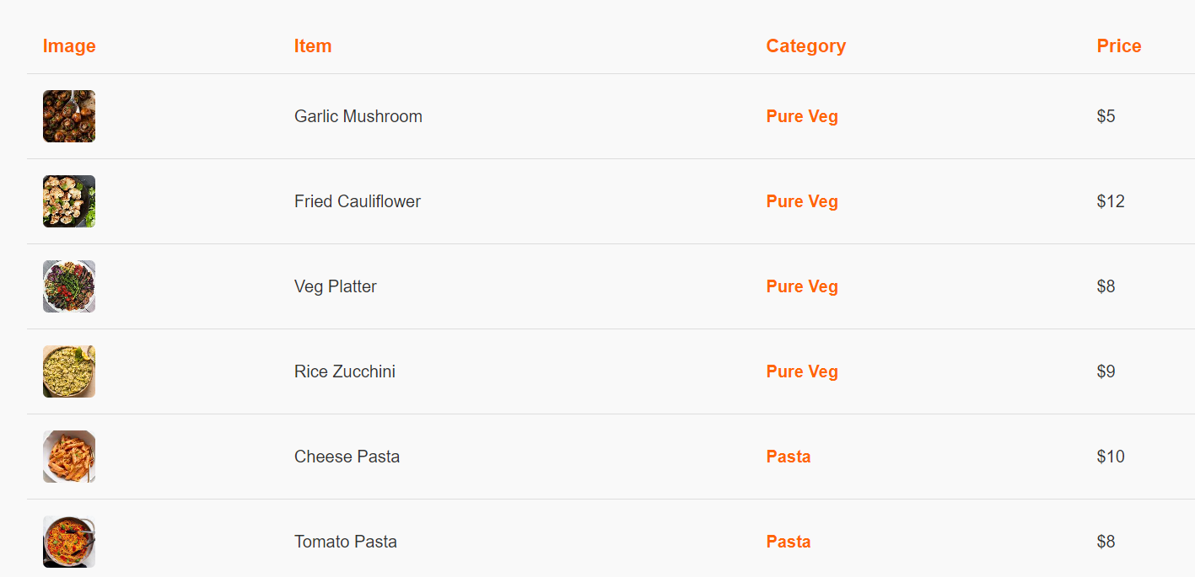

Slide 12
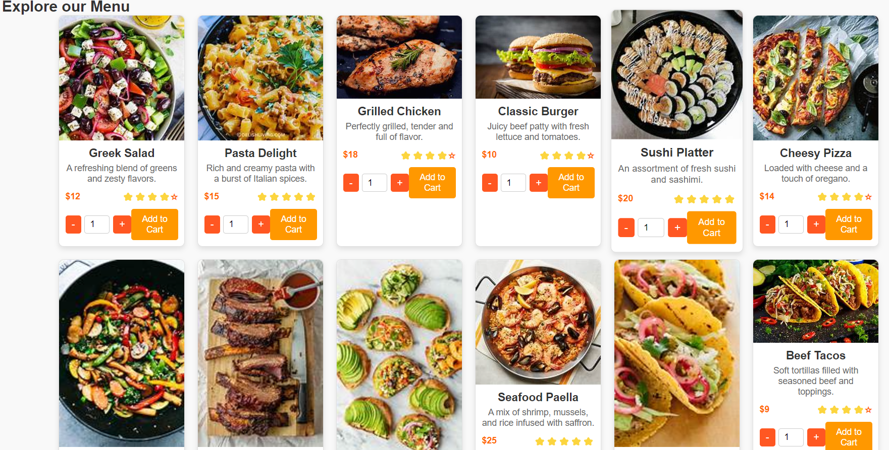

Slide 13
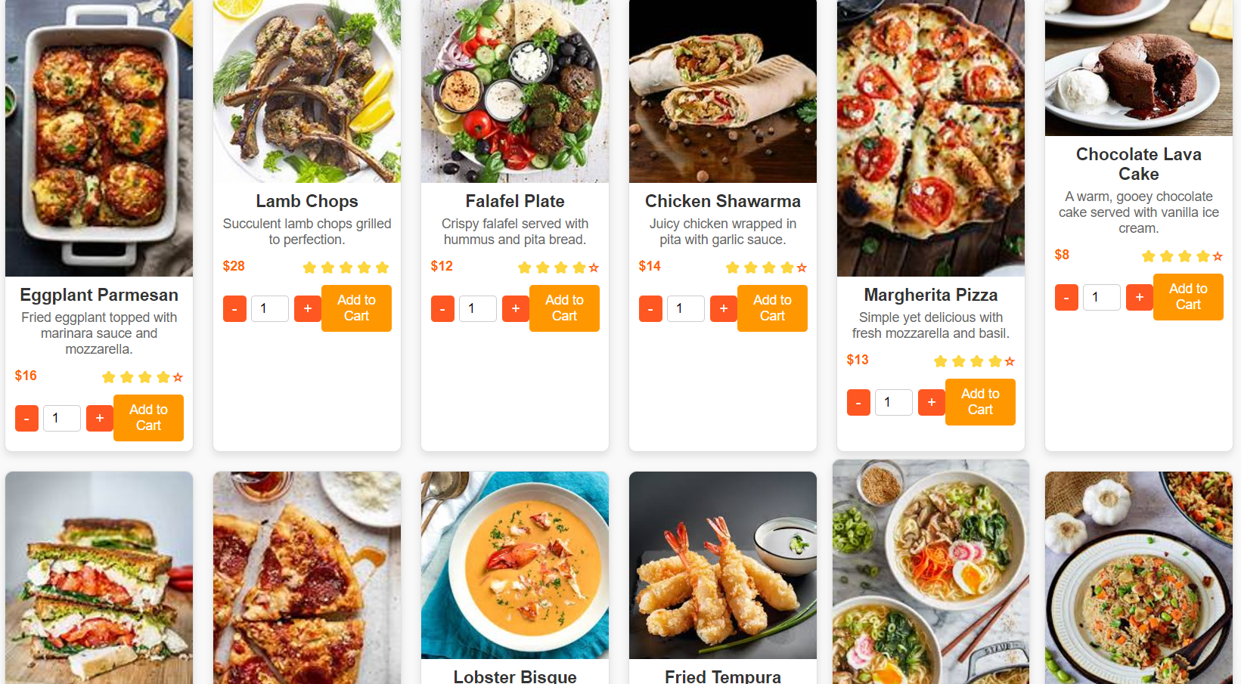

Slide 14
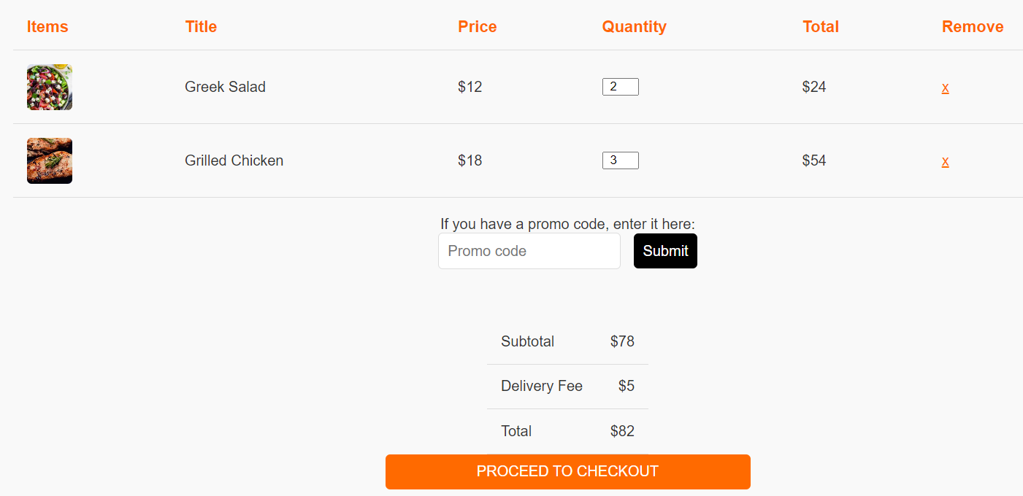
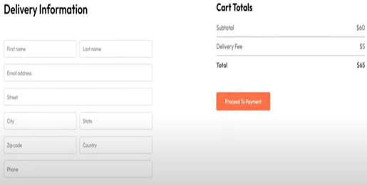

Slide 15
